Slide 1
Dr. Kirk Roberts Chief MRO
2022 DATIA Presentation
April 1, 2022

Slide 2
About Dr. Kirk Roberts
Integration with laboratories and clients for automated physician ordering and result review.
Dr. Kirk Roberts is a Medical Review Officer (MRO) who is a licensed physician and who is responsible for receiving and reviewing laboratory results generated by an employer's drug testing program and evaluating medical explanations for certain drug test results.
At the intersection of safety and health, we provide a unique medical model that delivers transparency and consistency in the evaluation of health and/or safety concerns while protecting client privacy.
Physician ordering, Medical Review of Records, Safety Sensitive Evaluations, Health Case Management, and Critical Results Review.

Slide 3
MRO Study of Post-Accident Positivity
Kirk Roberts, M.D. Lead MRO, Cynergy Wellness

Slide 4
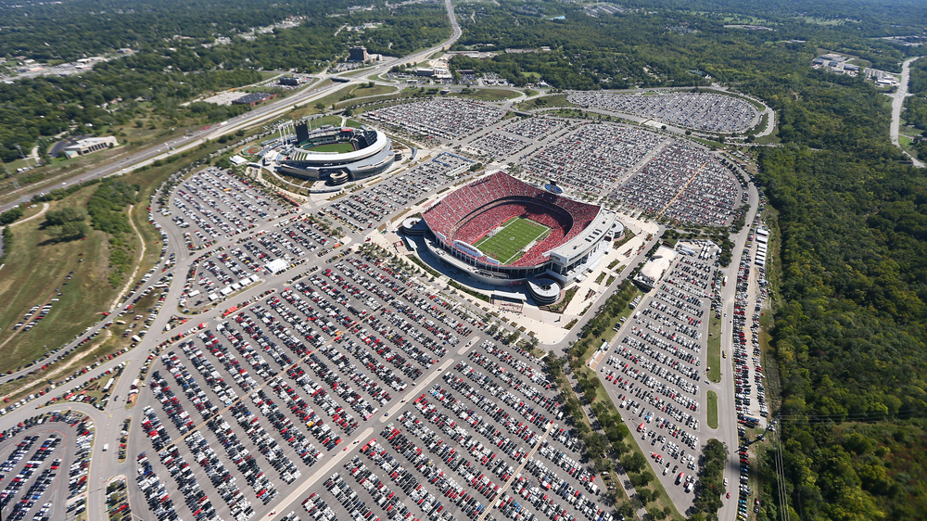
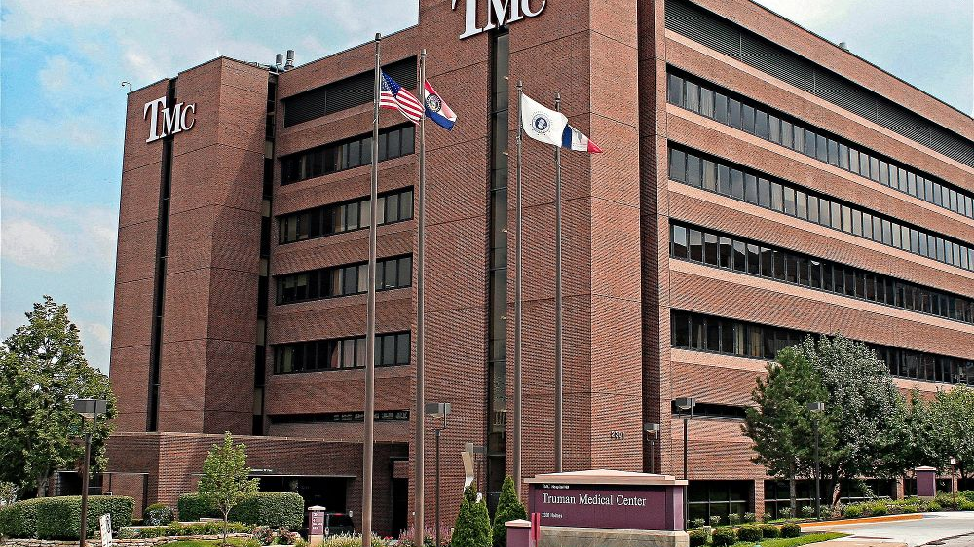
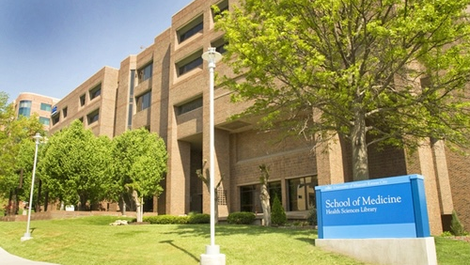
Kansas City, Missouri

Slide 5
Key Interest in Toxicology
Community ERs, level I II III
Trauma centers–Suburban and inner-city hospitals.
Drug testing would be initiated routinely with all trauma cases.
Blood alcohol
Urine immunoassay
Frequently drug testing would occur with patients with altered mental status and would run the gamut from alcohol to hallucinogens to more recently GHB.

Slide 6
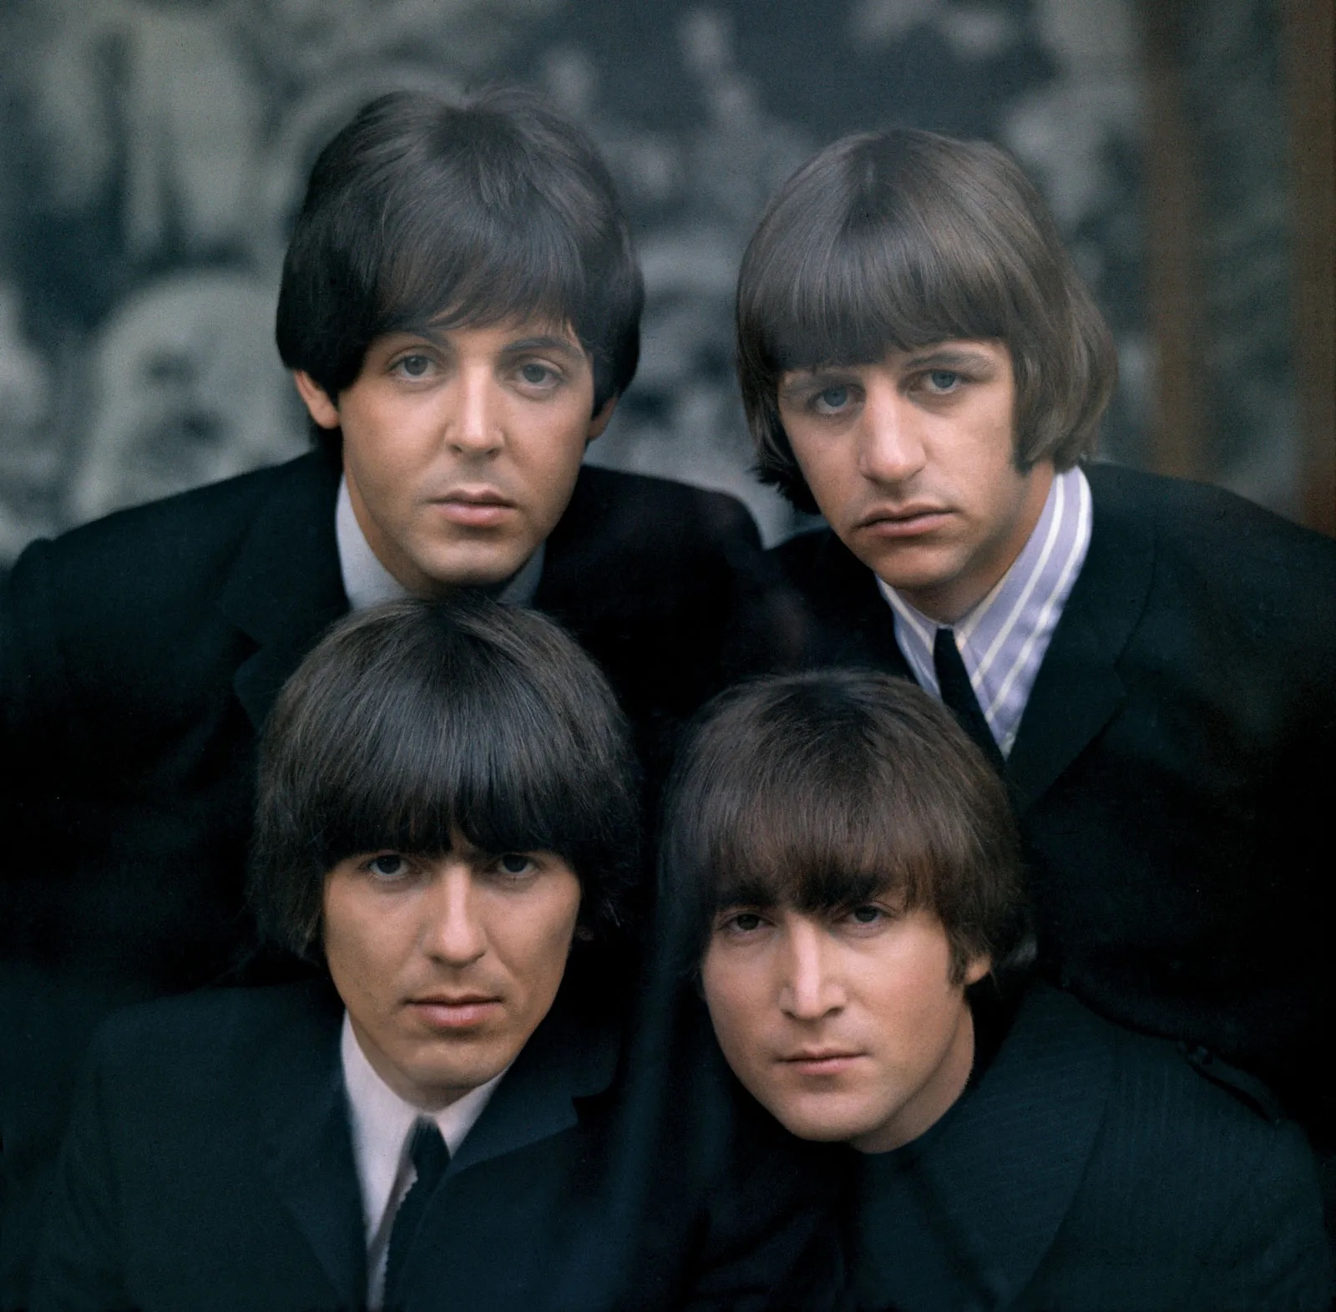
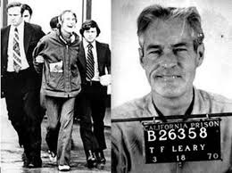
Timeline: 1960 - 1990
The Fab Four
Timothy Leary

Slide 7
Ten most commonly abused drugs in the US
Alcohol
Marijuana
Pain relievers (other than Heroin)
Hallucinogens
Depressants (tranquilizers and sedatives)
Cocaine
Prescription stimulants
Inhalants
Meth-amphetamines
Heroin

Slide 8
Alcohol vs. Marijuana
An Emergency Physician’s perspective

Slide 9
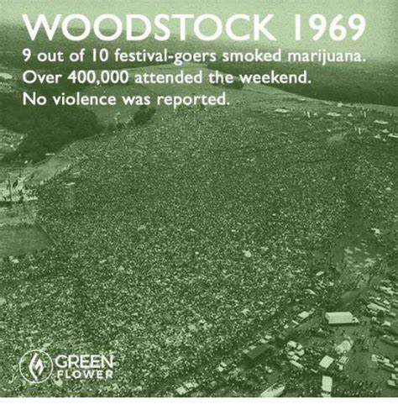
This isn’t your mom and dad’s marijuana…

Slide 10
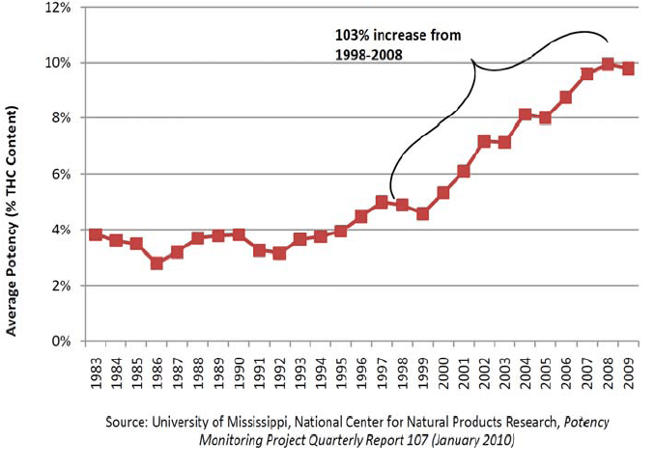
Potency of seized Marijuana in the US
Big jump in potency beginning in 1998

Slide 11
Changes in marijuana potency, frequency, form, and acceptance.

Slide 12
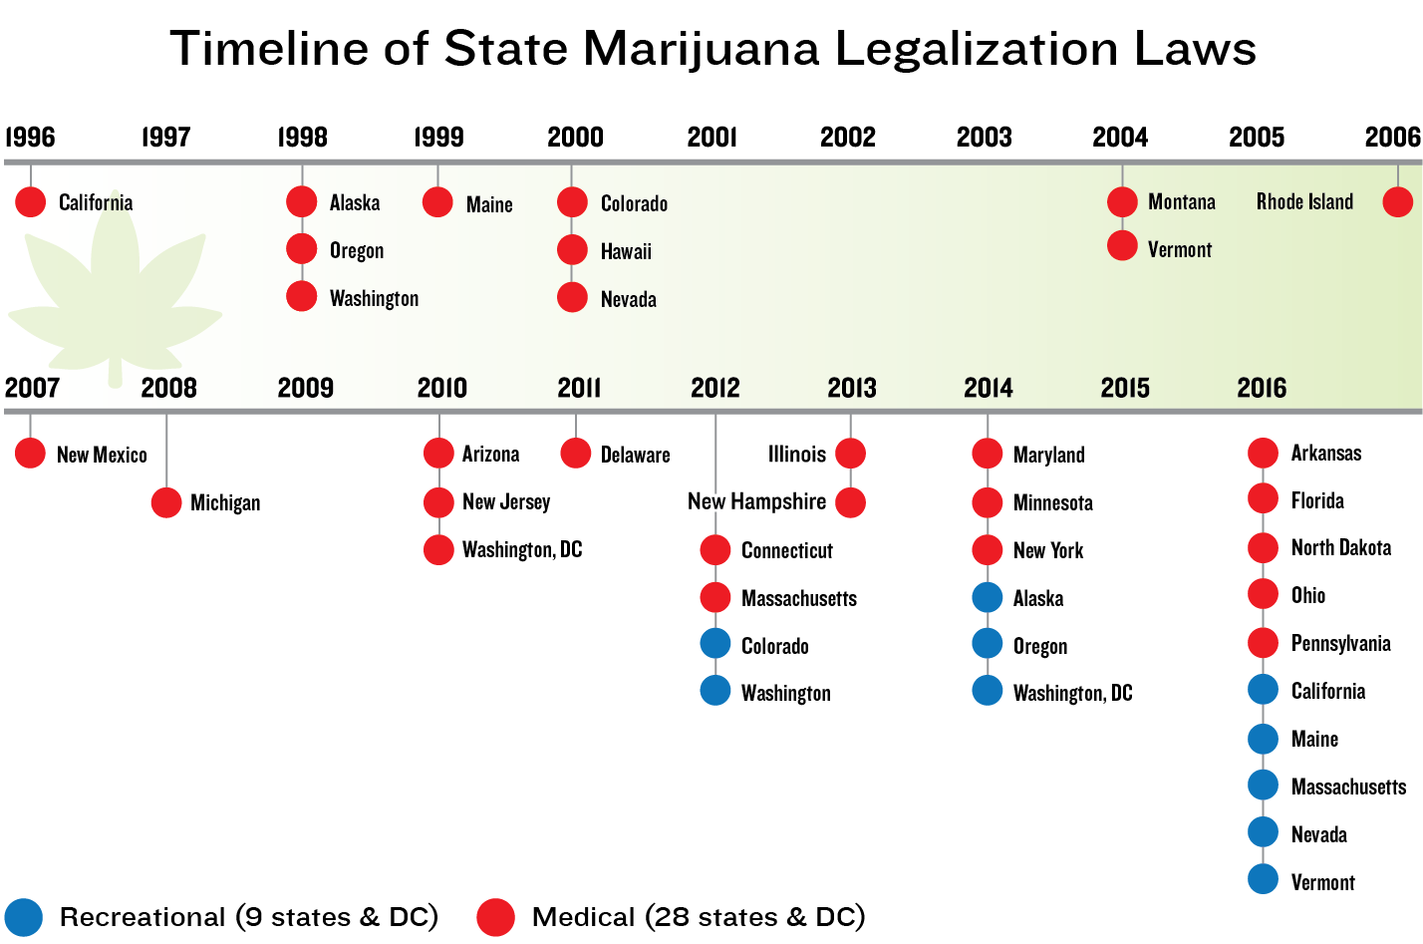
Marijuana timeline

Slide 13
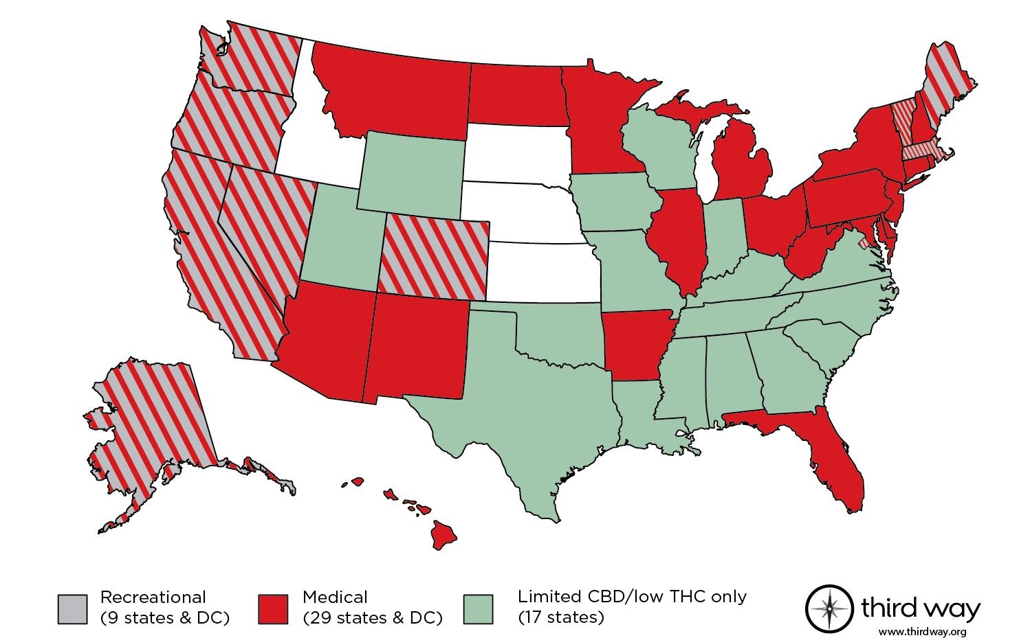
Marijuana State Map
Integration with laboratories and clients for automated physician ordering and result review.
At the intersection of safety and health, we provide a unique medical model that delivers transparency and consistency in the evaluation of health and/or safety concerns while protecting client privacy.
Physician ordering, Medical Review of Records, Safety Sensitive Evaluations, Health Case Management, and Critical Results Review.

Slide 14
Medical Review Office
Cynergy

Slide 15
How does the typical marijuana positive interview go?

Slide 16
But doc, I only use CBD….

Slide 17
2021 Quest Diagnostics Drug Testing Index™

Slide 18
Post-accident Results

Slide 19
2018 I began working as an MRO
Discussion of data
Discussion of causation
Trends in marijuana testing
State laws affecting testing
Cats out of the bag
Impairment
Future possibilities

Slide 20
Analysis of Post-Accident Non-Negative Results
Integration with laboratories and clients for automated physician ordering and result review.
At the intersection of safety and health, we provide a unique medical model that delivers transparency and consistency in the evaluation of health and/or safety concerns while protecting client privacy.
Physician ordering, Medical Review of Records, Safety Sensitive Evaluations, Health Case Management, and Critical Results Review.

Slide 21
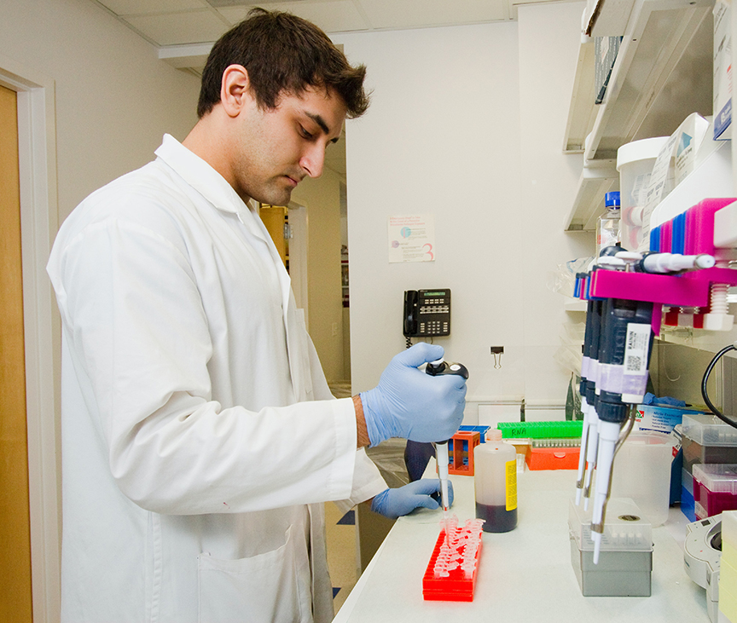
Seventeen of the tests were positive for Marijuana and an additional analyte
12 - Cocaine
5 - Methamphetamine
1 - Amphetamine
1 - Benzodiazepine
1 - PCP

Slide 22
89 of the 300 tests were positive for analytes other than Marijuana
34 – Opiates
26 – Amphetamines
14 – Cocaine
8 – Benzodiazepines
4- Methamphetamines
3 - Barbiturates

Slide 23
What are the limitations of this information?

Slide 24
There is ALWAYS room for more!

Slide 25
2021 Quest Diagnostics Drug Testing Index™

Slide 26
Marijuana Positivity

Slide 27
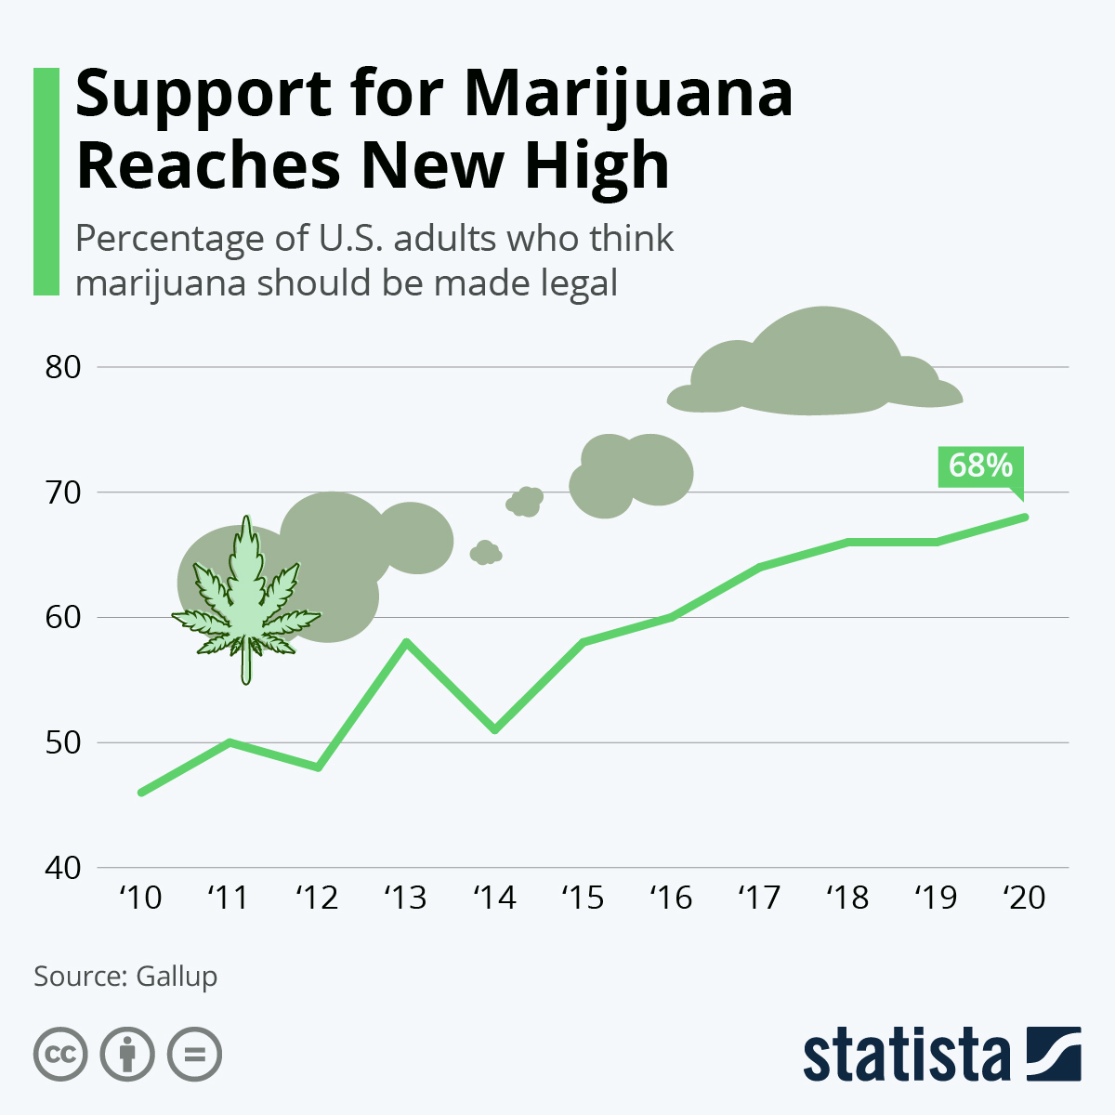
Support for Marijuana

Slide 28
Reasons For Marijuana Use
Euphoria
Relaxation
Altered perception of time
Increased appetite
Heightened sensory perception

Slide 29
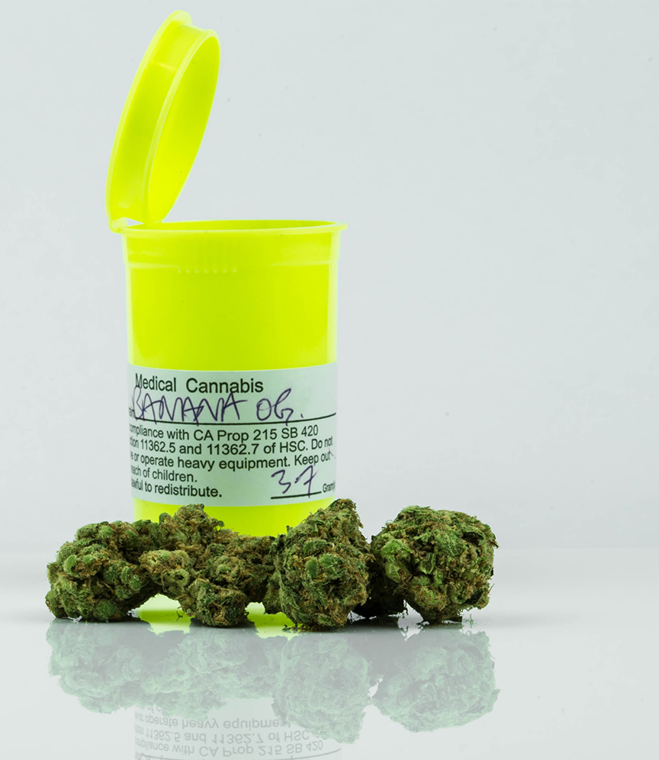
Medical Marijuana Indications
Cancer
PTSD
Cachexia or wasting syndrome
Seizure disorders
Nausea/pain

Slide 30
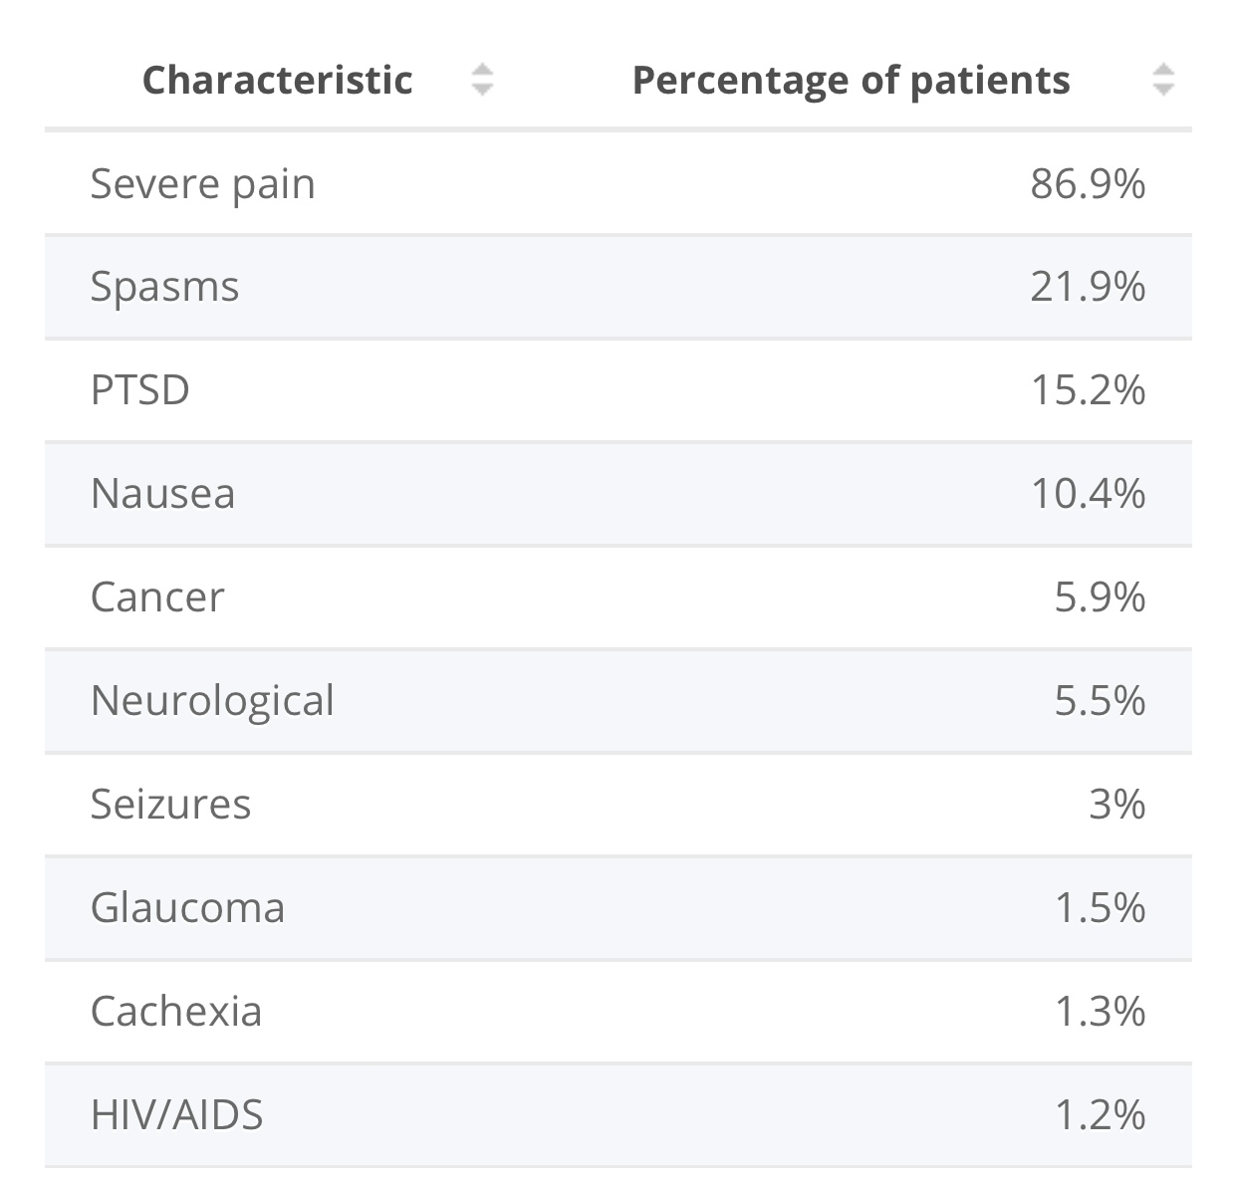
Distribution of medical marijuana patients registered in Oregon by condition as of April 2021*

Slide 31
Medical Marijuana

Slide 32
Who is writing for medical marijuana?

Slide 33
Impairment From Marijuana?
Slows reaction time
Impairs attention
Impairs concentration
Impairs short-term memory
Impairs risk assessment

Slide 34
Benefits of Drug Testing Programs
Improve employee productivity
Reduce on-the-job accidents and workplace crime
Reduce employee turnover
Decrease absenteeism
Lowers workers’ compensation insurance
Compliance with state or federal regulations

Slide 35
According to the National Council on Alcoholism and Drug Dependence Inc., Drug abuse costs employers $81 billion dollars annually. 70% of the estimated 14.8 million who use illegal drugs are employed.

Slide 36
Employees who use drugs are: 2.5 times more likely than co-workers to be absent for 8 or more days each year 3.6 times more likely to be involved in an accident at work 5 times more likely to file a workers’ compensation claim
SAMHSA Data

Slide 37
What is the future of drug testing?

Slide 38
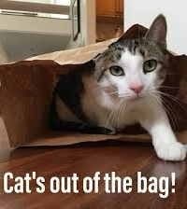
Marijuana is here to stay

Slide 39
Impairment is a growing concern

Slide 40
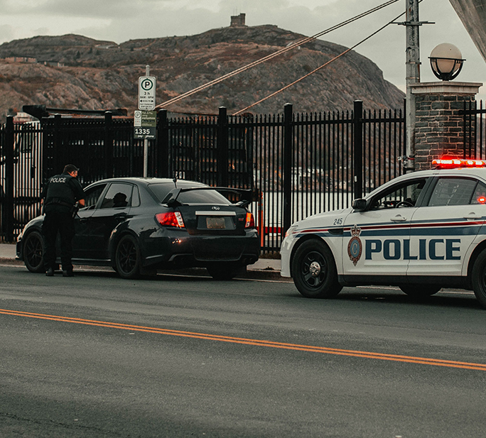
How can impairment be tested?

Slide 41
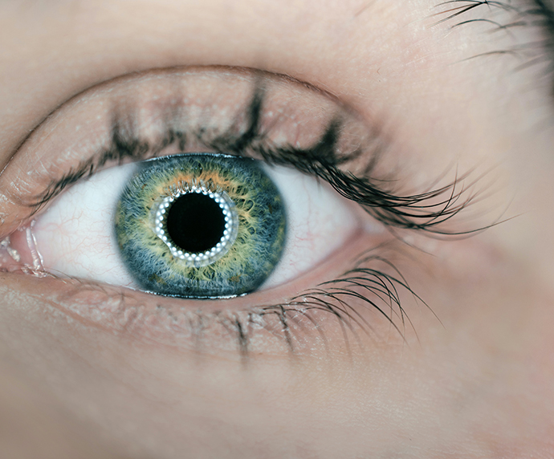
Ocular changes related to specific drugs

Slide 42
Additional tests on the horizon?

Slide 43
Let’s look at New Jersey. Now that recreational use is legal, can your boss fire you for smoking weed?

Slide 45
What is a WIRE?

Slide 46
Workplace Impairment Recognition Expert (WIRE)
An individual trained to detect and identify an employee’s use or impairment from marijuana or other intoxicating substances and to assist in the investigation of workplace accidents.

Slide 47
IN SUMMARY

Slide 48
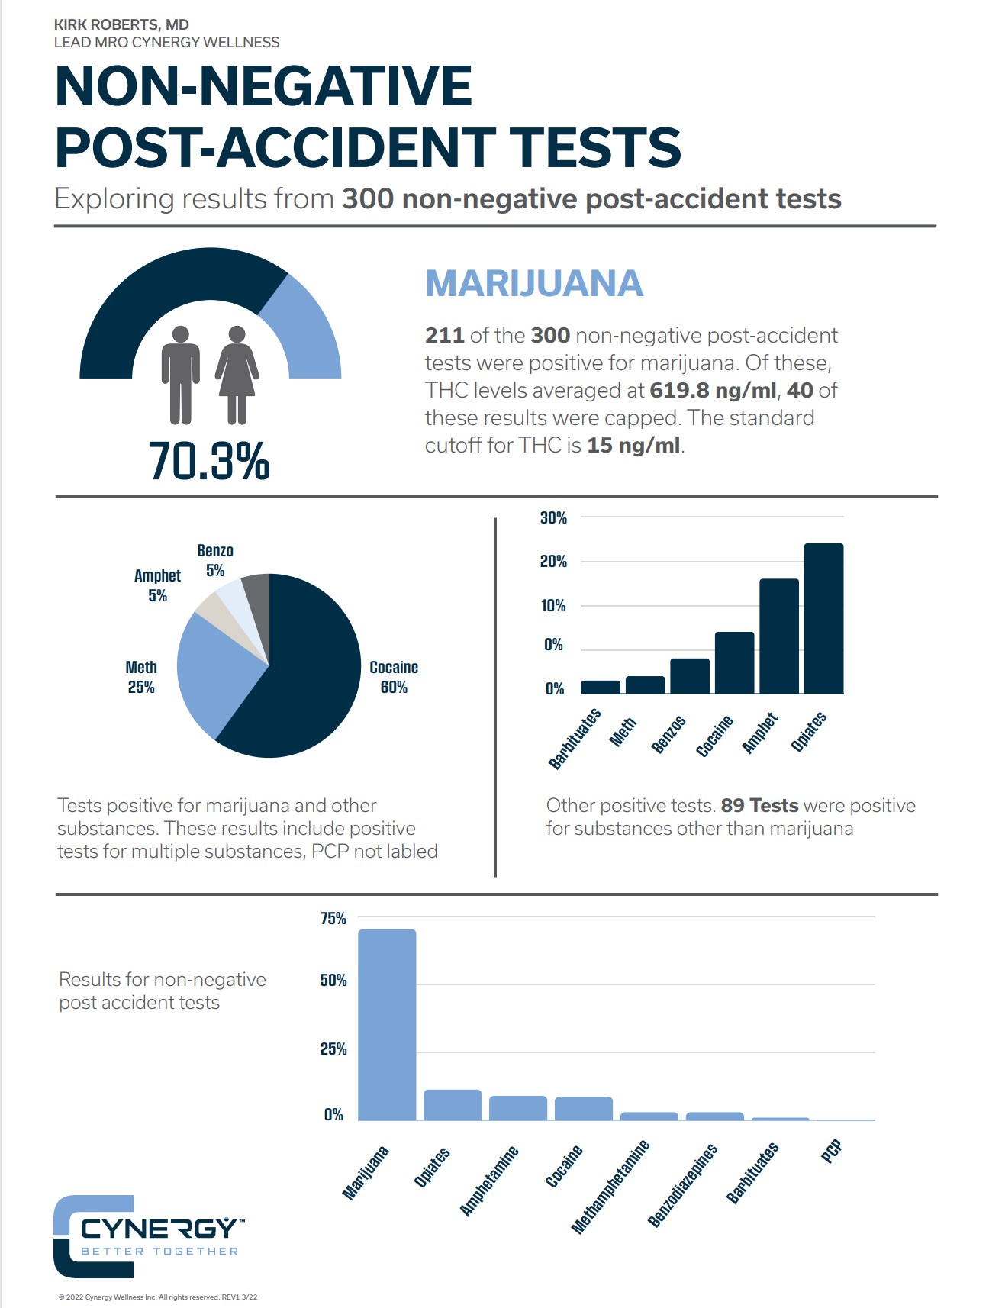
Non-Negative Post-Accident Tests

Slide 49
In keeping with the horse racing theme….

Slide 50
QUESTIONS?

Slide 51
Thank you!

